Slide 1


BASIC ELECTRONICS AND ELECTRICAL ENGINEERING
BY- CHANDANA MN (CSE-087)
HARSHITHA MASUR(AE-016)
PRIYANKA HANSDA(AE-009)
ASSIGNED BY- dr.HARINATH AIREDDY

Slide 2
ZENER DIODE AS VOLTAGE REGULATOR

Slide 3
ZENER DIODE
A Zener diode is a silicon semiconductor device that permits current to flow in either a forward or reverse direction. The diode consists of a special, heavily doped p-n junction, designed to conduct in the reverse direction when a certain specified voltage is reached.
The Zener diode has a well-defined reverse-breakdown voltage, at which it starts conducting current, and continues operating continuously in the reverse-bias mode without getting damaged.
the voltage drop across the diode remains constant over a wide range of voltages, a feature that makes Zener diodes suitable for use in voltage regulation.

Slide 4
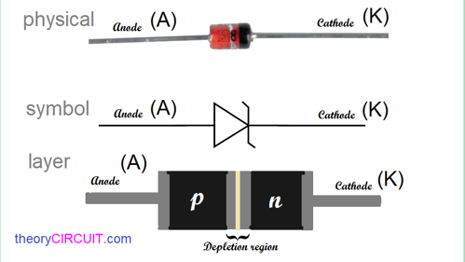

Slide 5
Zener diode operation
The Zener diode operates just like the normal diode when in the forward-bias mode, and has a turn-on voltage of between 0.3 and 0.7 V. (Turn-on voltage refers to the forward voltage of a semiconductor diode. It is the required voltage across the diode before it starts to conduct current in the forward direction.)
when connected in the reverse mode, which is usual in most of its applications, a small leakage current may flow. As the reverse voltage increases to the predetermined breakdown voltage (Vz), a current starts flowing through the diode.
The current increases to a maximum, which is determined by the series resistor, after which it stabilizes and remains constant over a wide range of applied voltage.

Slide 6
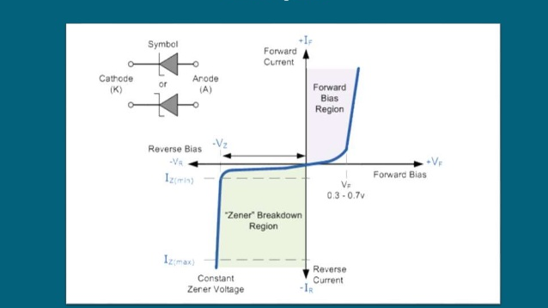

Slide 7

NOW LET US GO TO THE EXPERIMENT

Slide 8
Aim:
To study the functionality of Zener diode as voltage regulator and calculate its line and load regulation.

Slide 9
Apparatus Required:
Sl.No | Component | Range | Required
1 | Zener Diode | 5.1VZ | 1
2 | Resistor | 1.5KΩ | 1
3 | Variable DC power supply | 0-30V | 1
4 | Ammeter | 0-20mA | 1
5 | Voltmeter | 0-20V | 1
6 | DRB | - | 1
7 | Bread board & Wires | - | -

Slide 10
Theory:
The purpose of a voltage regulator is to maintain a constant voltage across a load regardless of variations in the applied input voltage and variations in the load current.
The zener conducts the least current when the load current is the highest and it conducts the most current when the load current is the lowest.
The voltage across the zener will remain steady at its break down voltage V_{Z} for all the values of zener current I_{Z} as long as the current remains in the break down region. Hence a regulated DC output voltage V₀ = V_{Z} is obtained across R_{L}, whenever the input voltage remains within a minimum and maximum voltage.

Slide 11

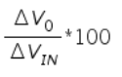
Basically there are two type of regulations such as:
a) Line Regulation
b) Load Regulation
In this type of regulation, series resistance and load resistance are fixed, only input voltage is changing. Output voltage remains the same as long as the input voltage is maintained above a minimum value.
Percentage of line regulation =
Where, ΔV₀ is the change in output voltage for a particular change in input voltage ΔV_{IN}.
In this type of regulation, input voltage is fixed and the load resistance is varying. Output voltage remains same, as long as the load resistance is maintained above a minimum value.
Percentage of load regulation =
Where, V_{NL} is the null load resistor voltage and V_{FL} is the full load resistor voltage.

Slide 12
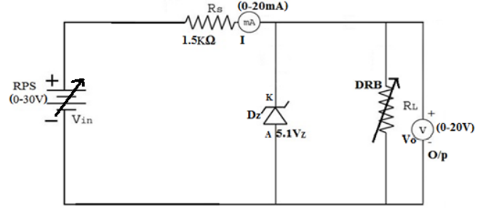
Circuit diagram:

Slide 13
Procedure:
1. Connect the circuit as shown in figure.
1
2. Set the load resistance (DRB) 1KΩ constant, vary the DC input voltage from 1V to 20V in steps of 3V.
2
3. Note down the corresponding output voltage (Vo) in voltmeter and current (I) in ammeter.
3
4. Calculate the percentage line regulation using formula Percentage of line regulation
4
5. Plot the graph V_{o} v/s V_{IN}.
5
Line Regulation:

Slide 14
Observation table:
Line Regulation [RL = 1KΩ constant]
Sl.No | V_{IN} in Volts | V_{O} in Volts | I in mA
1
2
3
4
5
6
7

Slide 15
Load Regulation:
1. Connect the circuit as shown in figure.
1
2. Set the DC input voltage V_{IN} = 8V constant and vary the DRB from 1KΩ to 10KΩ in steps of 1KΩ.
2
3. Note down the corresponding output voltage (Vo) in voltmeter and current (I) in ammeter.
3
4. To note down the no load voltage (VNL) remove the DRB connections and note down the no load voltage (VNL) across the voltmeter (Vo).
4
5. When the zener diode reaches break down region and note down the full load voltage (VFL) across the voltmeter (Vo).
5
6. Calculate the percentage load regulation using formula Percentage of load regulation
6
7. Plot the graph V_{o} v/s R_{L}.
7

Slide 16
Load Regulation [V_{IN} = 8V Constant]
Sl.No | R_{L} in Ω | V_{O} in volts | I in mA
1
2
3
4
5
6
7

Slide 17
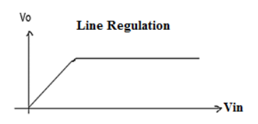
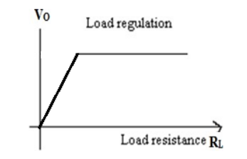
Model graph:
Line Regulation
Load Regulation

Slide 18
Result:
The functionality of Zener diode as voltage regulator is studied and calculated the line and load regulation and corresponding graphs are plotted.
% Line Regulation = ___________%
% Load regulation = ___________%

Slide 19
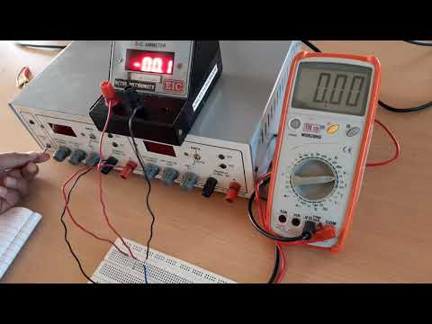

Slide 20
applications
A voltage regulator is designed to automatically ‘regulate’ voltage level. It basically steps down the input voltage to the desired level and keeps that in that same level during the supply. This makes sure that even when a load is applied the voltage doesn’t drop.
To regulate or vary the output voltage of the circuit.
To keep the output voltage constant at the desired value in-spite of variations in the supply voltage or in the load current.
Voltage regulators find their applications in computers, alternators, power generator plants where the circuit is used to control the output of the plant.

Slide 21


